Slide 1
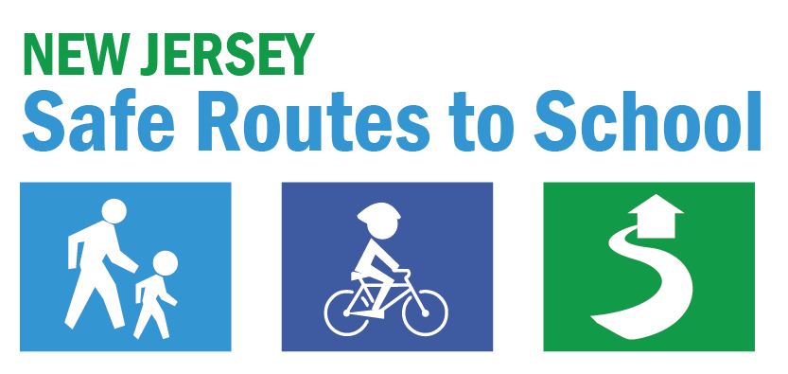

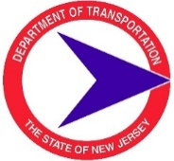

About the New Jersey Safe Routes to School Program
saferoutesnj.org
Notes:
The Safe Routes to School program is a federal, state, and local effort that creates safer and more appealing conditions for walking, bicycling, and using other wheeled active transportation devices as a healthy part of everyday life.

Slide 2
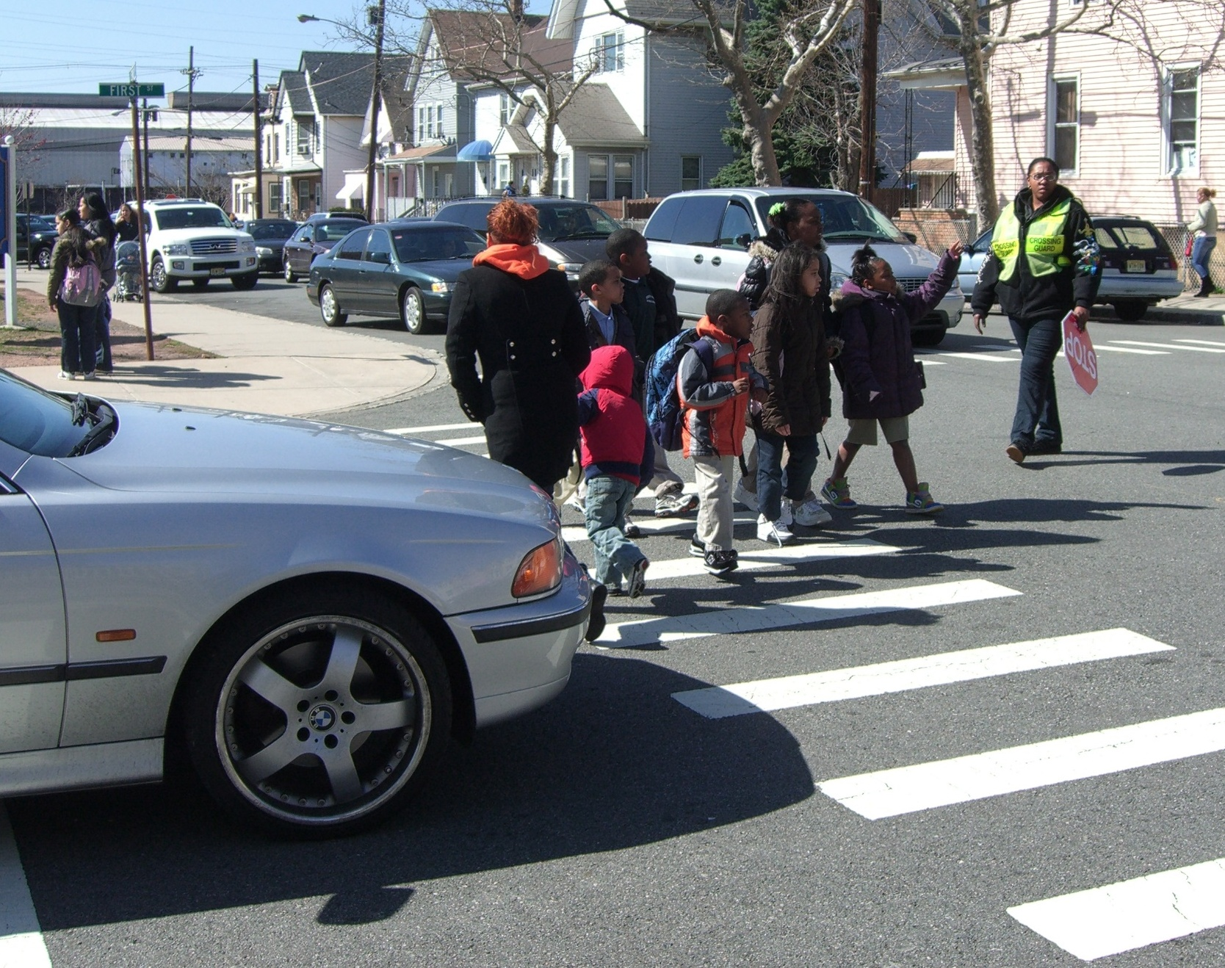
About Safe Routes to School
Where it’s safe, get youth including those with disabilities walking, bicycling, & rolling
Where it’s not safe, make it safe
Encourage children to walk, bike, & roll to school fostering a healthy, active lifestyle at an early age
About SRTS
Vision & Mission
Complete Streets
Safe System Approach
Three Pillars
NJ TMAs
NJDOT Safe Routes Resource Center
NJ Crossing Guards
NJDOT Bike Ped Resource Center
NJDOT
Contact
“Where it’s not safe, make it safe”
Notes:
The overarching program goal is where it’s safe, get youth, including those with disabilities, to walk, bicycle, and roll, and where it’s not safe, make it safe. The program aims to foster healthy and active lifestyles from an early age by facilitating the planning, development, and implementation of projects that improve safety for children and youth across all backgrounds and neighborhoods. This program recognizes that a lifetime of being active begins on the way to school.

Slide 3
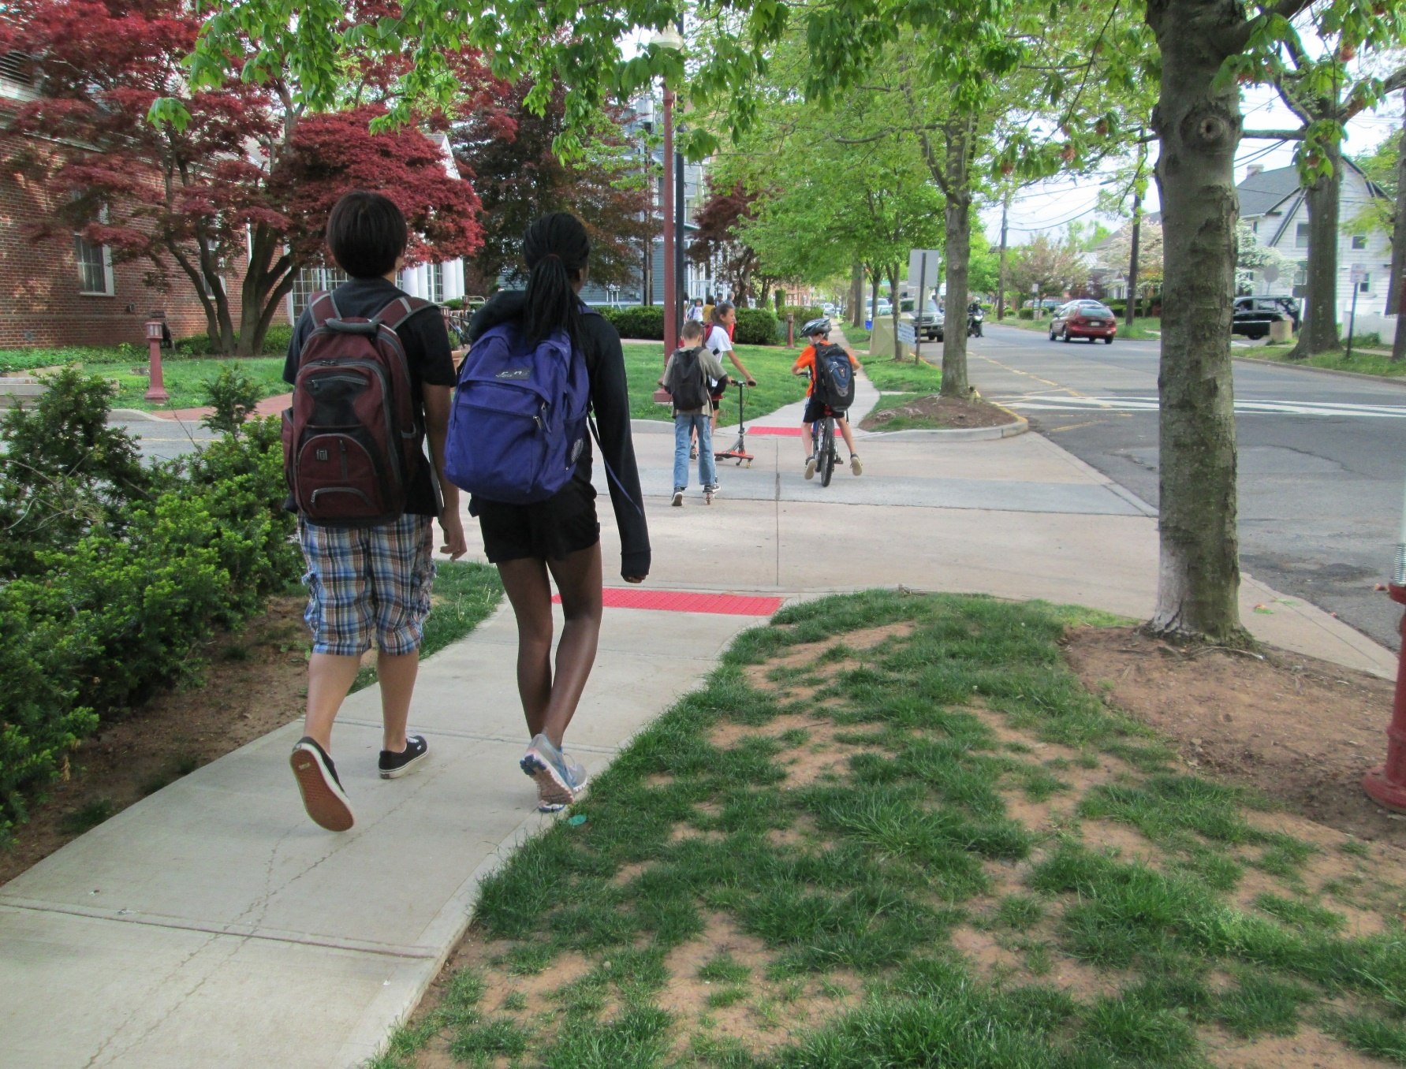
About Safe Routes to School
Prioritize where there has been underinvestment
Expand the program to high school students
Improve safety and accessibility for people walking, bicycling, and using other micromobility modes (scooters, e-scooters, e-bikes)
About SRTS
Vision & Mission
Complete Streets
Safe System Approach
Three Pillars
NJ TMAs
NJDOT Safe Routes Resource Center
NJ Crossing Guards
NJDOT Bike Ped Resource Center
NJDOT
Contact
SRTS expansion to high school students
Notes:
There are some important updates from the latest federal transportation bill that support Safe Routes to School. One key provision is the push to expand safe active transportation options for high school students, recognizing that teens and youth need safe ways to get to and from school and around their communities. There is also support for improving safety for micromobility, like e-scooters and e-bikes. With more people choosing these ways to travel, it’s important that our streets are designed to keep everyone safe. These updates give communities new tools and funding to make everyday travel safer and healthier for students and families.
https://www.saferoutesnj.org/wp-content/uploads/2020/07/Addendum_Safe-Routes_11.15-1.pdf

Slide 4

NJ Safe Routes to School Program Vision & Mission
Vision: Safe Routes to School for All provides access to active transportation for students of all ages and abilities from all backgrounds and neighborhoods in New Jersey.
About SRTS
Vision & Mission
Complete Streets
Safe System Approach
Three Pillars
NJ TMAs
NJDOT Safe Routes Resource Center
NJ Crossing Guards
NJDOT Bike Ped Resource Center
NJDOT
Contact
Mission: The NJ Safe Routes to School mission is to partner with schools and communities to prioritize and implement opportunities for people to walk, bike, or travel by other wheeled devices.
Notes:
The New Jersey program vision is simple but powerful: Safe Routes to School for All. That means no matter where students live, how old they are, or their ability level, they should have safe and welcoming active transportation options. The Safe Routes to School program’s mission is to work hand-in-hand with schools and communities to find and implement real solutions that support active transportation. When a community focuses on creating safer sidewalks, better road crossings, and more bicycle-friendly routes, they are not just improving travel, they are also investing in health, safety, and accessibility for everyone. Together, we can build communities where walking and bicycling aren’t just possible but preferred!

Slide 5
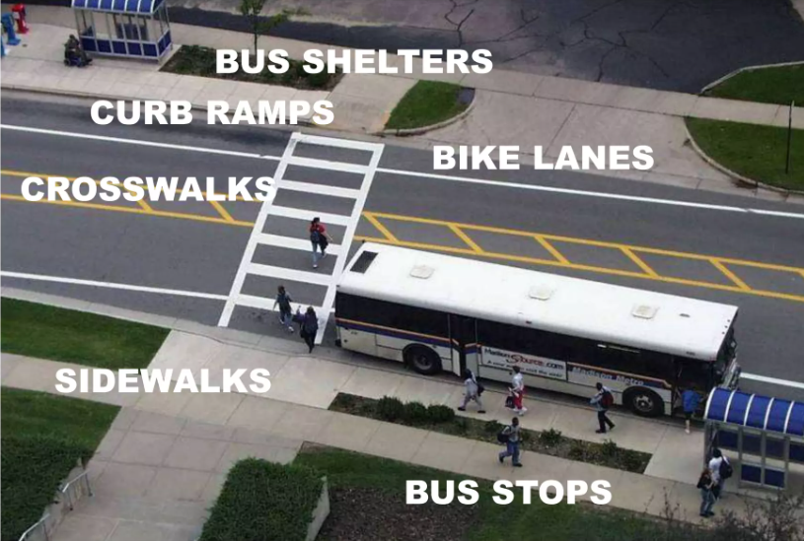
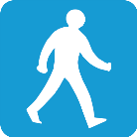





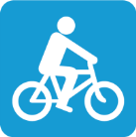
Complete Streets
Designed for everyone
Based on local context
Balance the needs of all modes, all users, and all abilities
About SRTS
Vision & Mission
Complete Streets
Safe System Approach
Three Pillars
NJ TMAs
NJDOT Safe Routes Resource Center
NJ Crossing Guards
NJDOT Bike Ped Resource Center
NJDOT
Contact
RAIN GARDEN
Complete Streets for
Complete Communities
Notes:
Safe Routes to School programs also complement Complete Streets. A Complete Streets approach focuses on designing streets to enable all road users to travel safely. Some key tenets of Complete Streets include:
Complete Streets are streets designed for everyone.
By everyone, we mean all roadway users, all travel modes including pedestrians, bicyclists, and transit users, and travelers of all ages and abilities.
In NJ, where we have significant levels of flooding, we also include Green Streets – or streets that address stormwater runoff through infrastructure.
Complete Streets ensure that street designs prioritize safety, mobility, and accessibility for users of all ages and abilities, fostering community-oriented transportation solutions.

Slide 6
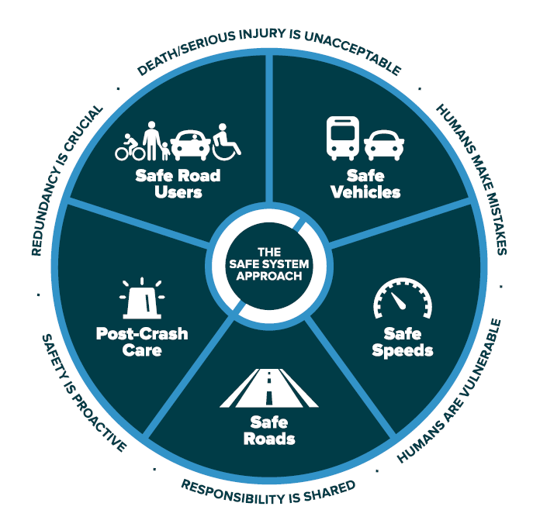

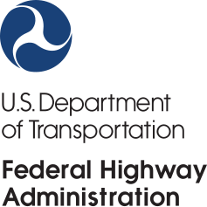
Safe System Approach
About SRTS
Vision & Mission
Complete Streets
Safe System Approach
Three Pillars
NJ TMAs
NJDOT Safe Routes Resource Center
NJ Crossing Guards
NJDOT Bike Ped Resource Center
NJDOT
Contact
Notes:
Safe Routes to School and Complete Streets are also part of a bigger national roadway safety effort called the Safe System Approach, led by the Federal Highway Administration. The Safe System Approach focuses on designing roads and systems that are more forgiving, so if someone messes up, it doesn’t end in tragedy. Some of the key ideas behind this approach include:
Understanding that human error is inevitable, we need to take proactive steps to prevent crashes before they happen.
Recognizing that safety is a shared responsibility between stakeholders, including government at all levels, industry, non-profits and advocacy, researchers, and the public.
And building in layers of protection, so if one safety measure fails, another can catch the mistake.
The Safe System Approach emphasizes comprehensive actions to significantly reduce serious and fatal road injuries, supported by a new slogan, "Zero is our goal, a safe system is how we get there."

Slide 7
Safe System Approach
U.S. DOT Vision for Roadway Safety
NJDOT Vision
Strategic Highway Safety Plan
About SRTS
Vision & Mission
Complete Streets
Safe System Approach
Three Pillars
NJ TMAs
NJDOT Safe Routes Resource Center
NJ Crossing Guards
NJDOT Bike Ped Resource Center
NJDOT
Contact
New Jersey’s vision is to achieve
zero deaths on all public roads.
Zero is the only acceptable number of deaths on our highways, roads, and streets.
NJ Target Zero Commission
Goal: eliminate traffic fatalities and serious injuries on all public roadways in the State by 2040.
Notes:
The U.S. Department of Transportation has made a bold commitment to reduce serious and fatal injuries on our roads to reach zero roadway deaths. This goal isn’t just about numbers. It’s about changing the way we think, where we no longer accept traffic deaths as inevitable. Instead, we treat them as preventable and unacceptable. In New Jersey, the Department of Transportation is on board with this vision. Through the Strategic Highway Safety Plan, NJDOT is working to make public roads in the state safer. To support this effort, the state legislator created the New Jersey Target Zero Commission in a bill signed by the governor. The mission is to create an Action Plan that identifies key policies, programs, and strategies to reach zero traffic fatalities by 2040.

Slide 8








GOAL
Zero deaths
About SRTS
Vision & Mission
Complete Streets
Safe System Approach
Three Pillars
NJ TMAs
NJDOT Safe Routes Resource Center
NJ Crossing Guards
NJDOT Bike Ped Resource Center
NJDOT
Contact
METHODS
COMPLETE STREETS
SAFE ROUTES TO school
SAFE Streets TO transit
STRATEGY.
SAFE SYSTEM APPROACH
Notes:
Complete Streets and Safe Routes to School are pivotal strategies in the pursuit of zero roadway deaths. Complete Streets policies focus on designing streets that accommodate safe usage by all users, while Safe Routes to School initiatives promote safe travel options for students, including education on pedestrian and bicyclist safety.
This diagram provides a relationship between zero death initiatives, the Safe System Approach, and Complete Streets, which include Safe Routes to School and Safe Streets to Transit. The goal is zero deaths on our roads. The System Approach outlines the strategy for this goal. Complete Streets and Safe Routes to School provide methods to reach the goal of zero deaths.

Slide 9
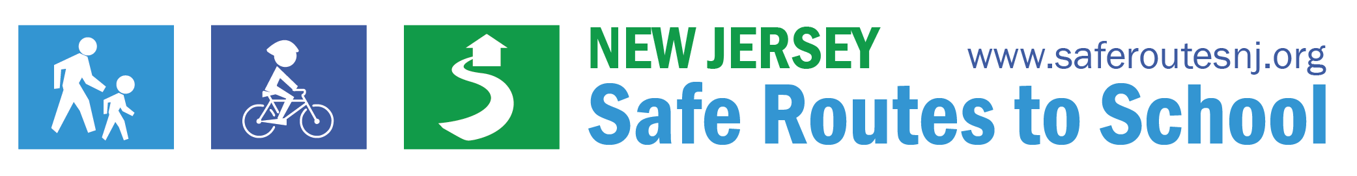
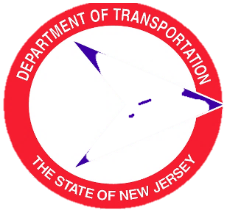
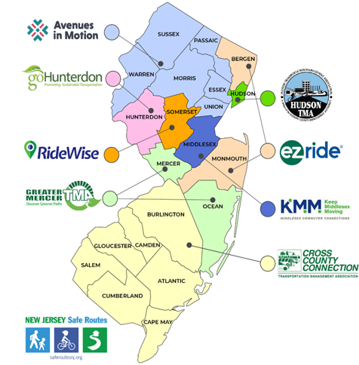
Three Pillars of the NJ SRTS Program
About SRTS
Vision & Mission
Complete Streets
Safe System Approach
Three Pillars
NJ TMAs
NJDOT Safe Routes Resource Center
NJ Crossing Guards
NJDOT Bike Ped Resource Center
NJDOT
Contact
The Three Pillars of New Jersey Safe Routes to School Program
NJ Department of Transportation
NJ Safe Routes
Resource Center
Rutgers University
8 Transportation Management Associations in NJ
Notes:
Now let’s take a closer look at how Safe Routes to School works in New Jersey. The program is built around three key pillars that help shape safer, healthier communities.

Slide 10
8 Transportation Management Associations in NJ
Notes:
The first pillar of New Jersey’s Safe Routes to School program is support from regional Safe Routes to School Coordinators housed within New Jersey’s Transportation Management Associations. New Jersey is served by eight Transportation Management Associations, or TMAs. When it comes to funding, infrastructure grants, like building sidewalks or improving crossings, are managed through the NJ Department of Transportation. But for non-infrastructure support, things like education programs, events, and planning help, that’s where the TMAs come in. They receive funding from NJDOT to provide Safe Routes to School services for free to schools and municipalities.

Slide 11
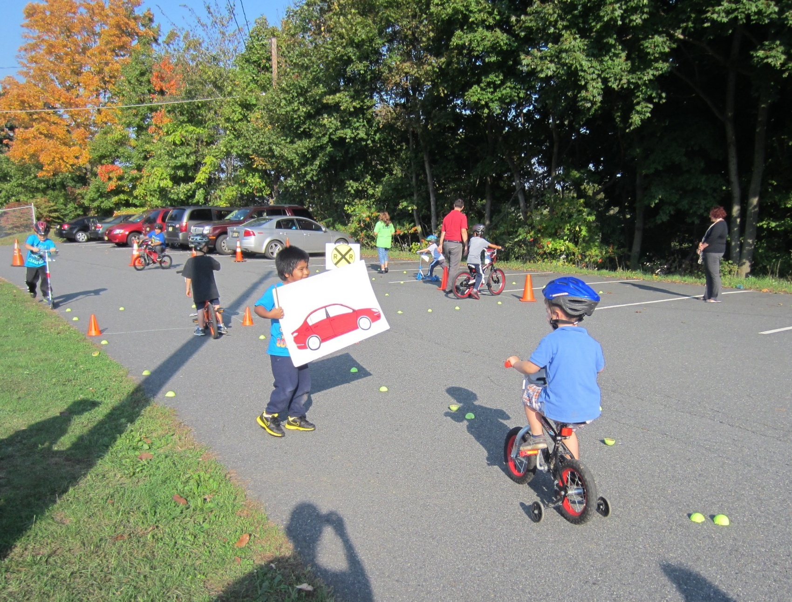
TMA Regional SRTS Coordinators
Walk and Bike to School Events
Bicycle and Pedestrian Safety Education
Walk and Bike Assessments
School Travel Plans
Student Contests
NJ SRTS Recognition Program
Supportive Policies for Schools and Complete Streets
Sustainable Jersey
About SRTS
Vision & Mission
Complete Streets
Safe System Approach
Three Pillars
NJ TMAs
NJDOT Safe Routes Resource Center
NJ Crossing Guards
NJDOT Bike Ped Resource Center
NJDOT
Contact
Free Assistance from NJ TMAs
Notes:
Safe Routes to School Regional Coordinators offer free assistance with:
Walk and bike to school events.
Bicycle and pedestrian safety education.
School travel plans.
Walk and bike audits around schools.
Safe Routes to School Recognition Award Program applications.
Supportive policies for walking, bicycling, and Complete Streets.
Help with Sustainable Jersey points.
and other innovative programs and projects to support safer walking, bicycling, and rolling.

Slide 12
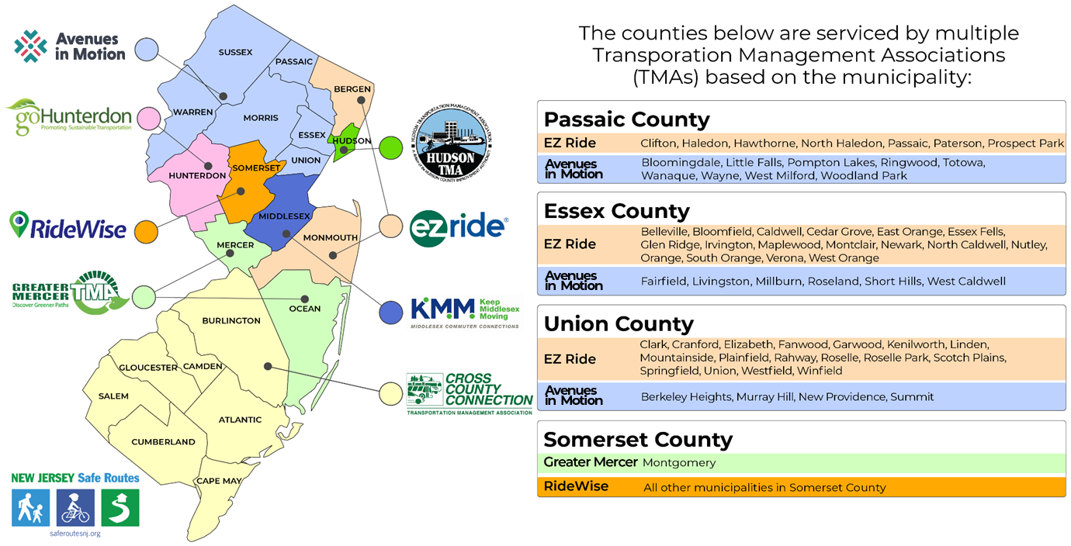
TMA Regional SRTS Coordinators
About SRTS
Vision & Mission
Complete Streets
Safe System Approach
Three Pillars
NJ TMAs
NJDOT Safe Routes Resource Center
NJ Crossing Guards
NJDOT Bike Ped Resource Center
NJDOT
Contact
Visit saferoutesnj.org/find-your-srts-regional-coordinator
Notes:
Together, the eight TMAs cover every part of the state. So, no matter where you live in New Jersey, there’s a local Safe Routes to School coordinator ready to help bring Safe Routes to School to your neighborhood. It’s easy to find your Transportation Management Association Safe Routes to School coordinator. If you’re not sure which TMA serves your community, you can easily find out by visiting saferoutesnj.org/find-your-srts-regional-coordinator.

Slide 13
The Three Pillars of New Jersey Safe Routes to School Program
NJ Department of Transportation
NJ Safe Routes
Resource Center
Rutgers University
8 Transportation Management Associations in NJ

Slide 14
NJDOT Safe Routes to School Resource Center
Rutgers University
Notes:
The second pillar of New Jersey’s Safe Routes to School program is the support provided by NJDOTs Safe Routes to School Resource Center at Rutgers University. This team plays a key role in helping communities make walking and bicycling safer and more accessible across the state. They work with public officials, transportation and health professionals, and even parents and volunteers, by sharing research, training, and best practices in safe street design and planning.

Slide 15
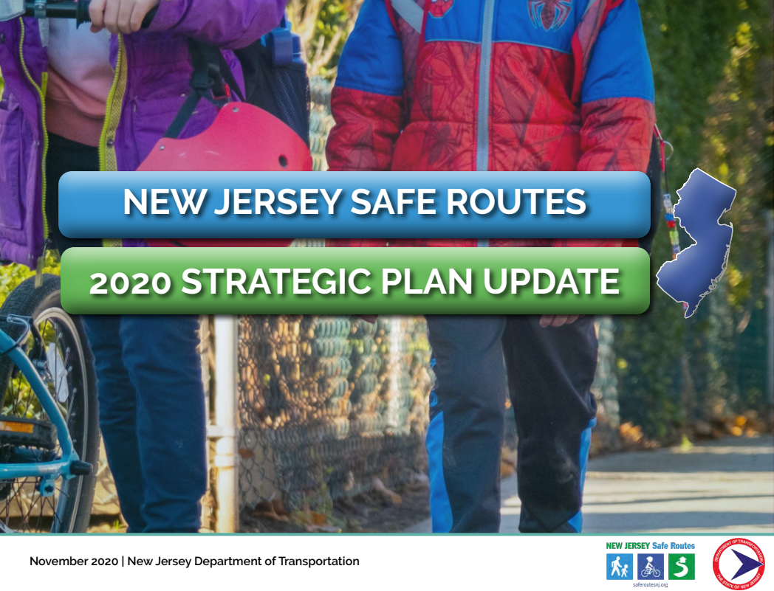
NJDOT Safe Routes to School Resource Center
Educate about safe walking & bicycling
Encourage implementation of safe, accessible infrastructure
Develop & disseminate research and best practices
About SRTS
Vision & Mission
Complete Streets
Safe System Approach
Three Pillars
NJ TMAs
NJDOT Safe Routes Resource Center
NJ Crossing Guards
NJDOT Bike Ped Resource Center
NJDOT
Contact
Strengthening Safe Routes to School through knowledge
Notes:
The NJ Safe Routes to School Resource Center also helps develop policies and procedures that support Safe Routes to School, and they provide education and outreach to Regional Coordinators and local champions, people who want to make a difference in their communities. Their goal is to make sure everyone has the tools and knowledge needed to start or strengthen a Safe Routes to School program.

Slide 16
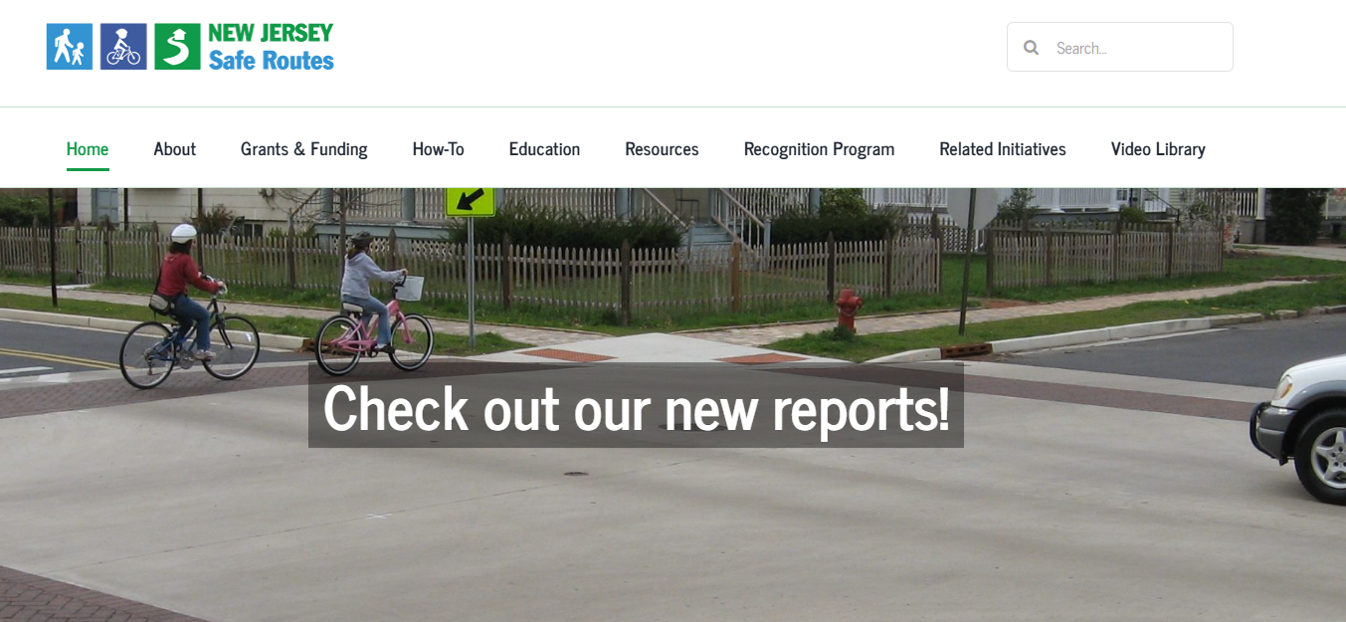
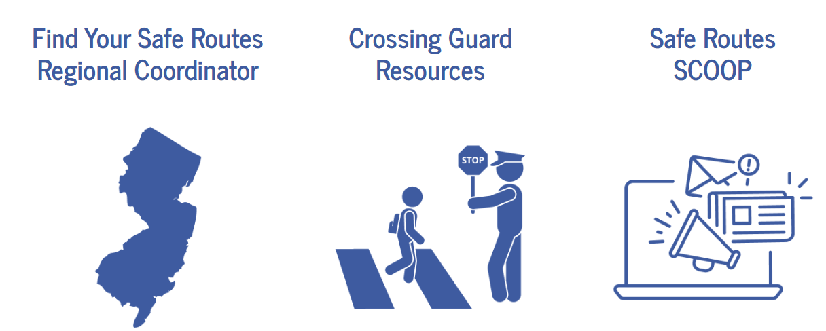
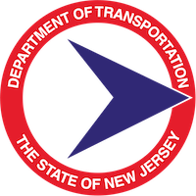
NJDOT Safe Routes to School Resource Center
Find your TMA SRTS Coordinator
Grant Information
Safety Lesson Plans
How-To & Case Study Videos
Crossing Guard Resources
Design Guides
Policy Documents
Research Studies
Help Desk
About SRTS
Vision & Mission
Complete Streets
Safe System Approach
Three Pillars
NJ TMAs
NJDOT Safe Routes Resource Center
NJ Crossing Guards
NJDOT Bike Ped Resource Center
NJDOT
Contact
Help Desk at SafeRoutesNJ.org
Notes:
Among the resources the NJ Safe Routes to School Resource Center provides includes:
Finding your TMA SRTS Coordinator
Grant Information
Safety Lesson Plans
How-To & Case Study Videos
Crossing Guard Resources
Design Guides
Policy Documents
Research Studies
and a Help Desk

Slide 17






Safe Routes to School Program Recognition
About SRTS
Vision & Mission
Complete Streets
Safe System Approach
Three Pillars
NJ TMAs
NJDOT Safe Routes Resource Center
NJ Crossing Guards
NJDOT Bike Ped Resource Center
NJDOT
Contact
Recognition Program
Safe Routes to School
Complete and Green Streets for All
Bicycle and/or Pedestrian Audit
Bicycle and/or Pedestrian Plan
Bicycle and/or Pedestrian Improvements
Safe Routes to School District Policy
Complete and Green Streets for All
Bicycle and Pedestrian Safety & Promotion
School Travel Plan for Walking and Bicycling
The deadline to apply is January 31 each year
Notes:
The New Jersey Safe Routes Resource Center also recognizes the hard work of schools and municipalities that are committed to making it safer for students to walk and bike. That’s done through the Safe Routes to School Recognition Program, a statewide program that celebrates those who are building healthier, safer communities. There are four recognition levels: First Step, Bronze, Silver, and Gold. Each level includes different activities that show your school or town is taking real action to support student safety and health. The deadline to apply is January 31 each year.
This program also connects with Sustainable Jersey. For example, if your school or town earns the Silver-level SRTS recognition, you’ll automatically get points toward the Safe Routes to School action in Sustainable Jersey or Sustainable Jersey for Schools. If you’re not familiar with Sustainable Jersey, it’s a great resource for your community. Visit sustainablejersey.com and explore their many programs and actions. The staff at the Safe Routes Resource Center helps review all the bicycle and pedestrian-related actions in both Sustainable Jersey and Sustainable Jersey for Schools.

Slide 18
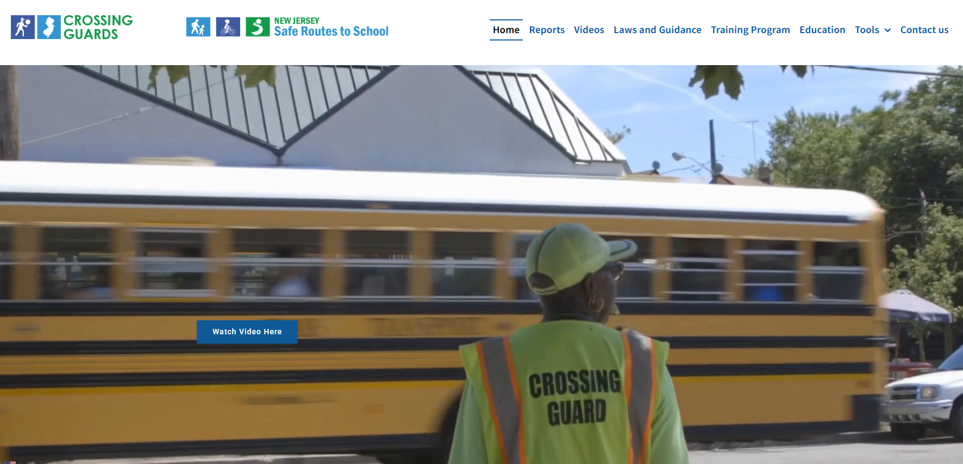
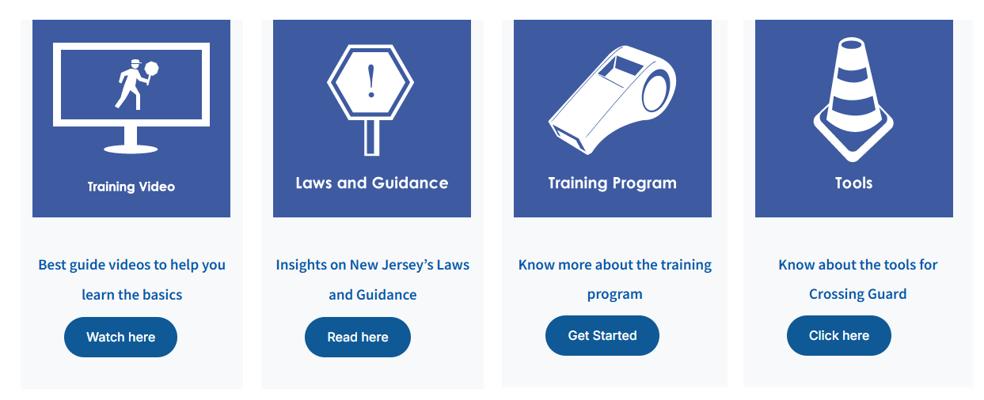

NJ Crossing Guards Training & Resources
About SRTS
Vision & Mission
Complete Streets
Safe System Approach
Three Pillars
NJ TMAs
NJDOT Safe Routes Resource Center
NJ Crossing Guards
NJDOT Bike Ped Resource Center
NJDOT
Contact
Training Programs
Training Videos
Laws and Guidance
Safety Resources
Policy Documents
Research Studies
SRTS Help Desk
njcrossingguards.org
Notes:
Another important part of the NJ Safe Routes to School Resource Center is the New Jersey Crossing Guard Training and Resources Program, which is co-funded by NJDOT and the NJ Division of Highway Traffic Safety. This program provides research-based training and helpful tools for both school crossing guards and the traffic safety officers who supervise them. Crossing guards play a big role in keeping kids safe on their way to and from school, and they also help teach children how to cross streets safely by setting a good example. This program ensures crossing guards are well-prepared for their duties. If your town needs crossing guard training or resources, visit njcrossingguards.org or contact the SRTS help desk.

Slide 19
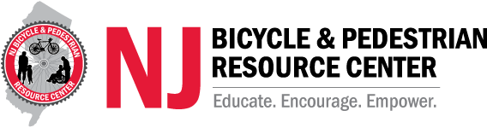
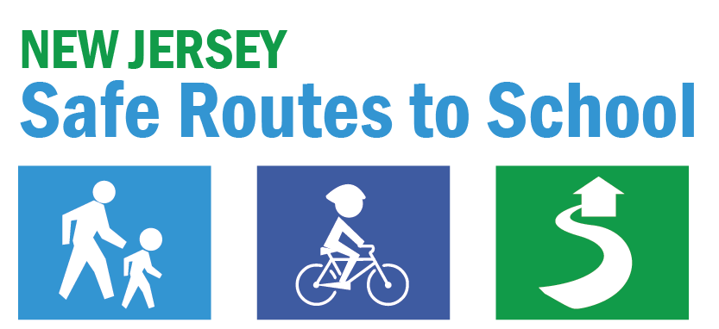

Contact:
NJDOT Safe Routes Resource Center
saferoutesnj.org
NJ Crossing Guard Resource Center
njcrossingguards.org
Telephone: (848) 932-7901 Email: srts@ejb.rutgers.edu
Contact:
NJDOT Bicycle & Pedestrian Resource Center
njbikeped.org
Telephone: (848) 932-3714 Email: bikeped@ejb.rutgers.edu
Notes:
Another key partner in this work is NJDOT’s Bicycle and Pedestrian Resource Center, also known as the BPRC. It is a sister center to the Safe Routes to School Resource Center and is also funded by the New Jersey Department of Transportation. The BPRC provides support to public officials, transportation and health professionals, and community members in creating safer, more accessible environments for walking, bicycling, and using low-speed micromobility devices such as e-scooters and e-bikes. Both centers work together to advance efforts that make active transportation safer and more practical throughout New Jersey.
.

Slide 20
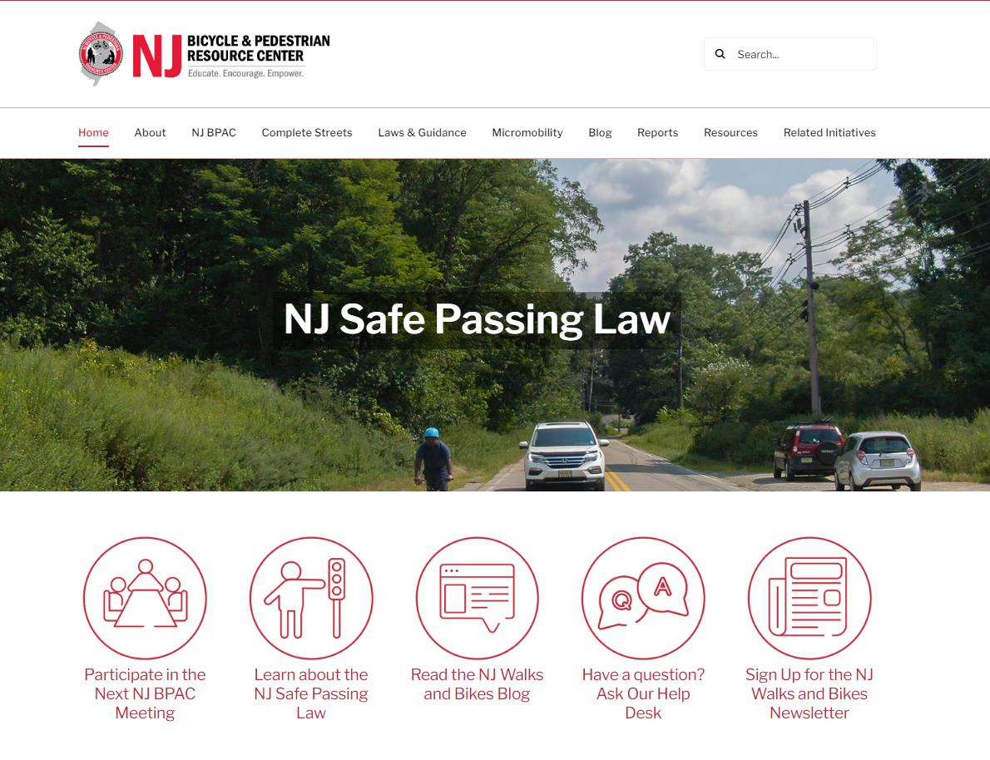
NJ Bicycle & Pedestrian Resource Center
About SRTS
Vision & Mission
Complete Streets
Safe System Approach
Three Pillars
NJ TMAs
NJDOT Safe Routes Resource Center
NJ Crossing Guards
NJDOT Bike Ped Resource Center
NJDOT
Contact
Complete Streets Policies in NJ
Complete Streets Technical Assistance
Laws & Guidance
Micromobility (e-bikes, e-scooters)
Research Studies
Help Desk
NJDOT Complete Streets Summit
NJDOT Bicycle & Pedestrian Advisory Council
Help Desk at NJbikeped.org
Notes:
Among the resources and assistance the NJ Bicycle & Pedestrian Resource Center provides are support with:
Complete Streets Policy adoption in NJ
Complete Streets Technical Assistance
Laws & Guidance
Micromobility best practices
Research Studies
and a Help Desk
In addition, the BPRC supports the NJ Department of Transportation by hosting the NJ Complete Streets Summit and the NJ Bicycle & Pedestrian Advisory Council.

Slide 21







Subscribe to Newsletters & Visit Social Media
About SRTS
Vision & Mission
Complete Streets
Safe System Approach
Three Pillars
NJ TMAs
NJDOT Safe Routes Resource Center
NJ Crossing Guards
NJDOT Bike Ped Resource Center
NJDOT
Contact
@SafeRoutesNJ
@njbikeped
saferoutesnj.org
njbikeped.org
Subscribe to NJ SRTS
& NJ Bike/Ped Newsletters
Notes:
Both the Safe Routes to School Resource Center and the Bicycle and Pedestrian Resource Center offer monthly newsletters and maintain active social media accounts. These newsletters are a great way to stay informed about upcoming initiatives, funding opportunities, and best practices related to bicyling, walking, and Safe Routes to School programs in New Jersey. Anyone interested in supporting safer, healthier communities is encouraged to subscribe and follow for regular updates.
Subscribe to the NJ SRTS Scoop - https://visitor.r20.constantcontact.com/manage/optin?v=001C5QOjSvqJgw5ANozt7uYiqw3bZceftyj5I0B208edl4KfiCM6vCovoDEpqkKaXYU9u5ZgO3z6ZqvNXxkcSxkE9RRLy6XsMyQFCx4zwZBfPx2IOf9HHLfwNQ1pTkxA08yUJY3ayA9eii94QauQqi8PFmZLWRsbAjSv10Lmk7bgoELikKbe3k63EZt9FnVv8hP_Qr4F6a4rFY%3D
Subscribe to the NJ Walks and Bikes Newsletter, https://visitor.r20.constantcontact.com/manage/optin?v=001g6CvqRJSkzohczUoz0qXfhie_Jpp2VfewzNw08lM9Cecjx3w8bHP_WwNIyLgi42cGg8y82MchtnWTdcbUe-tFKSdJmppAn-vEz1B8Fgg1eTXET1qWfUZvJHc0rMd6uhf_4RAGxqbVg33wtRdjIC-kQ%3D%3D

Slide 22
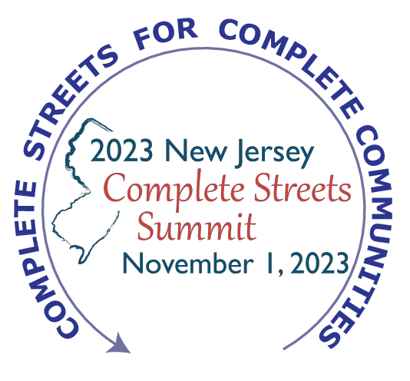
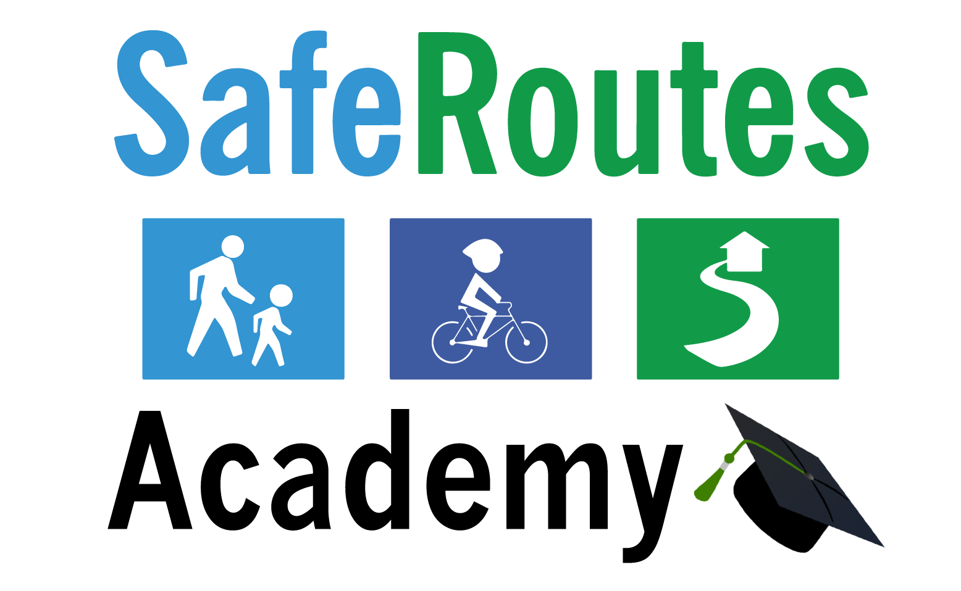
saferoutesnj.org/safe-routes-academy
njbikeped.org/about-complete-streets-in-nj
Notes:
There are also opportunities to attend in-person events that offer a chance to network, ask questions, and engage directly with experts and peers. The annaual New Jersey Safe Routes Academy provides a valuable opportunity to attend sessions focused on making communities more walk- and bike-friendly. These events are designed for parents, teachers, students, municipal leaders, volunteers, and anyone interested in improving conditions for walking and bicycling. Attendees learn about best practices, success stories, and tools they can take back and apply in their own communities.
Held every other year, NJDOTs Complete Streets Summit brings together planners, engineers, health professionals, public officials, and advocates, creating a space for learning, collaboration, and inspiration as communities across New Jersey work toward safer, healthier streets. Interactive training sessions covering all aspects of Complete Streets are also available.

Slide 23
The Three Pillars of New Jersey Safe Routes to School Program
NJ Department of Transportation
NJ Safe Routes
Resource Center
Rutgers University
8 Transportation Management Associations in NJ
Notes:
The 3rd pillar of the Safe Routes to School Program is the funder….the NJ Department of Transportation.

Slide 24
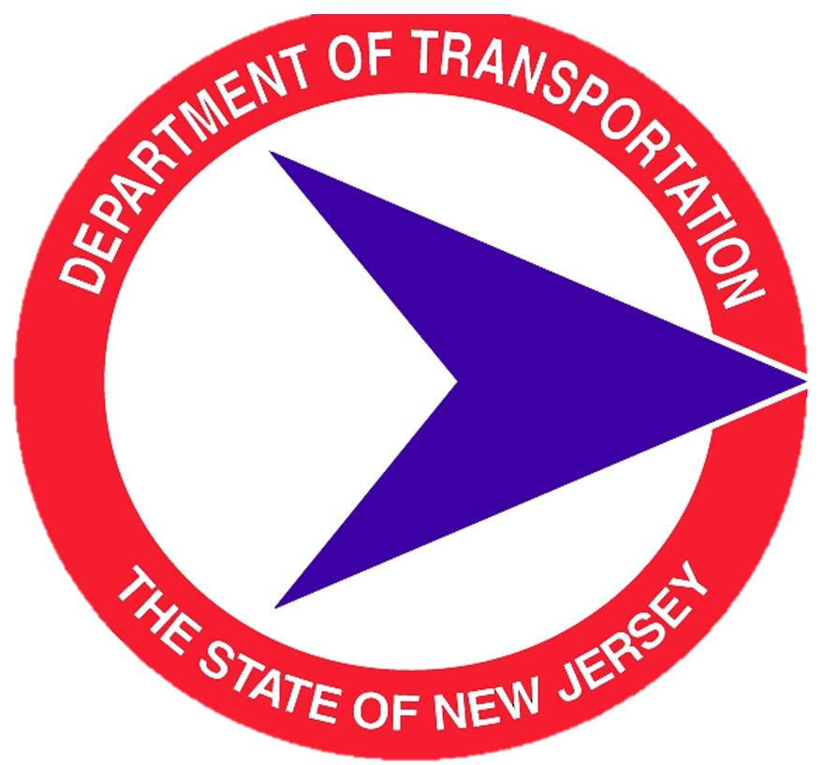
The Three Pillars of New Jersey Safe Routes to School Program
NJ Department of Transportation
Notes:
The New Jersey Department of Transportation oversees New Jersey’s Safe Routes to School program, ensuring alignment with state transportation goals. The mission of NJDOT is to provide a world-class transportation system that, among other things, enhances the quality of life for residents and the traveling public. NJDOT is responsible for planning and coordinating federal and state transportation projects and funds the TMA Safe Routes to School regional coordinators and the Safe Routes to School Resource Center.

Slide 25
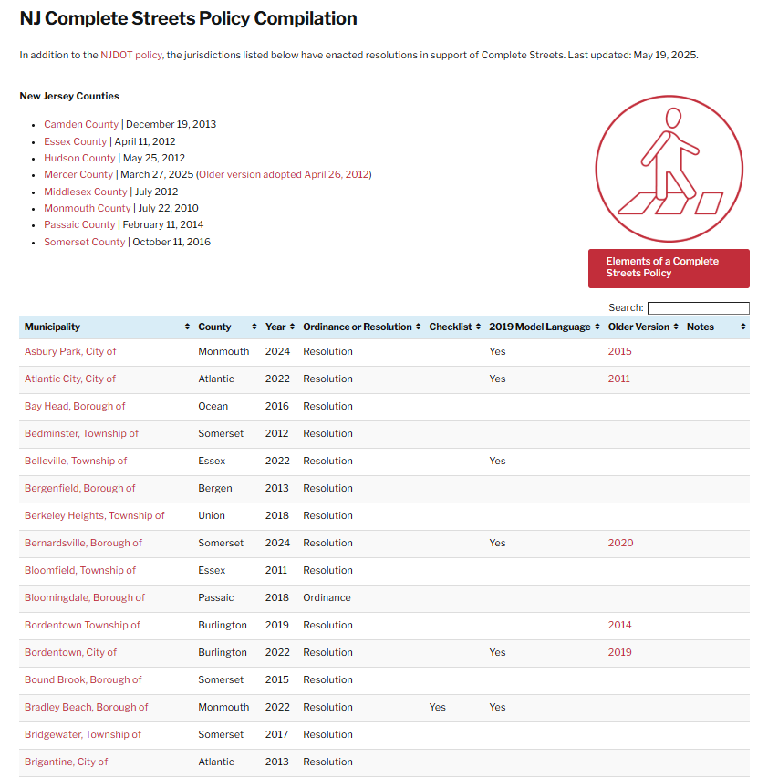
NJDOT Complete Streets
2024 Policy Update: NJDOT revised its Complete Streets Policy
Building on Experience: Enhances their 2009 policy with lessons learned over 15 years
Statewide Impact: Guides infrastructure projects and funding decisions across NJ
About SRTS
Vision & Mission
Complete Streets
Safe System Approach
Three Pillars
NJ TMAs
NJDOT Safe Routes Resource Center
NJ Crossing Guards
NJDOT Bike Ped Resource Center
NJDOT
Contact
www.nj.gov/transportation/about/safety/completestreets.shtm
NJ Complete Streets Policy Compilation at NJbikeped.org
Notes:
Another important way NJDOT supports Safe Routes to School is by offering tools and resources to help municipalities and counties adopt and implement their own Complete Streets policy. NJDOT is a statewide leader in implementing and promoting Complete Streets policies. In December 2024, NJDOT updated its internal Complete Streets Policy, building on its 2009 policy to reflect over a decade of experience, community input, and evolving transportation priorities. By also supporting the local adoption of Complete Streets, NJDOT is helping to build a transportation system that’s safer, more accessible, and more connected for all New Jersey residents.

Slide 26
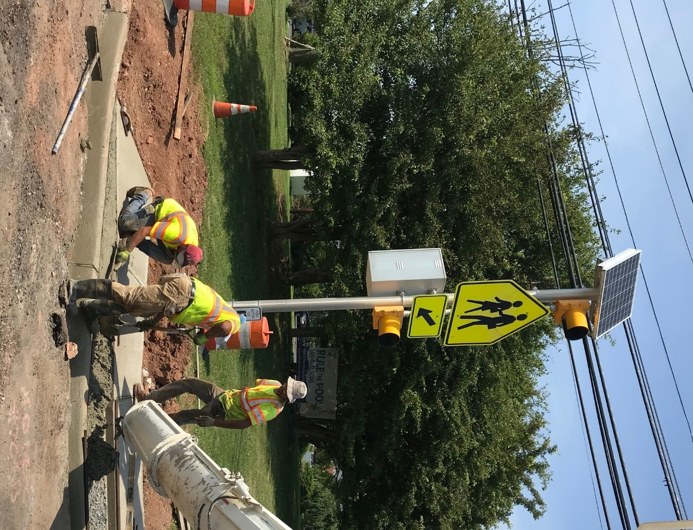
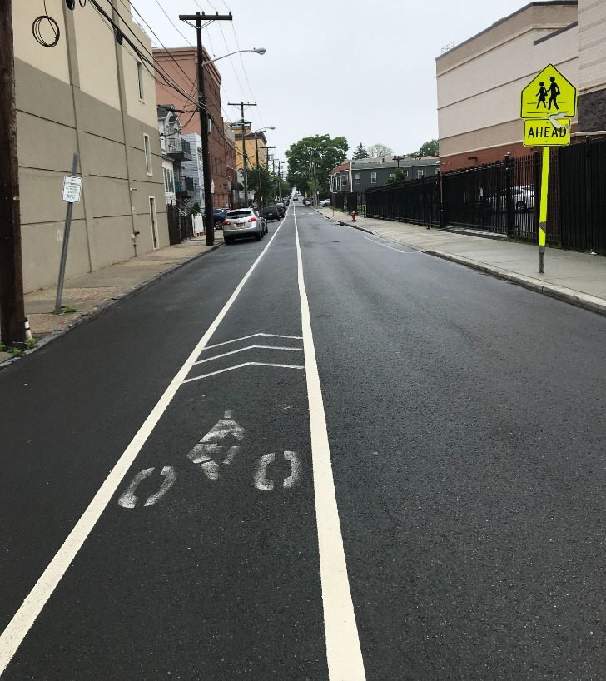
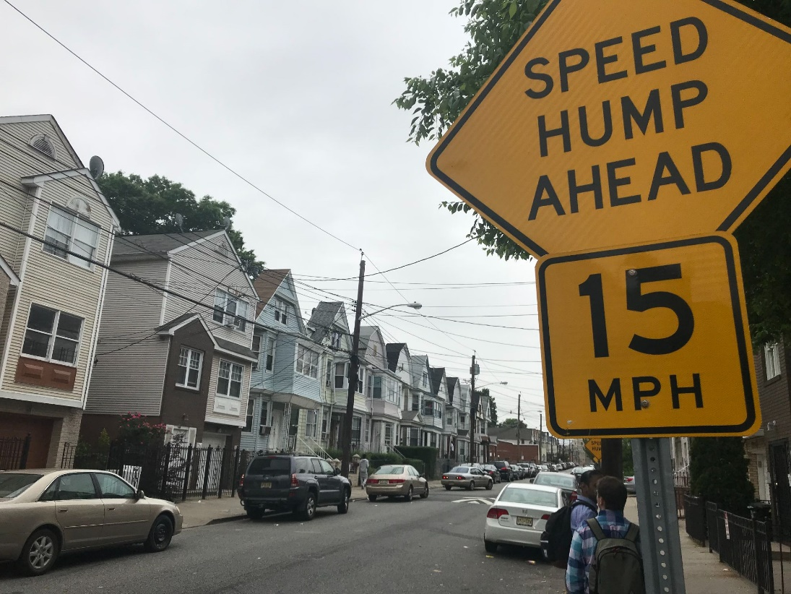
NJDOT SRTS Infrastructure Funding
What SRTS projects are eligible?
Facilitate walking and/or bicycling to school
Must be within 2 miles of a K-12 school
Infrastructure projects only
Within the public right-of-way and may include projects on private land that have public access easements
About SRTS
Vision & Mission
Complete Streets
Safe System Approach
Three Pillars
NJ TMAs
NJDOT Safe Routes Resource Center
NJ Crossing Guards
NJDOT Bike Ped Resource Center
NJDOT
Contact
Notes:
The New Jersey Department of Transportation provides federal funding to schools and communities to improve walking and bicycling conditions through the Safe Routes to School Infrastructure Grant Program. NJDOT solicits grant applications for infrastructure funding in partnership with the State’s three Metropolitan Planning Organizations. Grant solicitations are typically available every two years. Infrastructure projects include the planning, design, and construction or installation of sidewalks, crosswalks, signals, traffic-calming, and bicycle facilities.

Slide 27
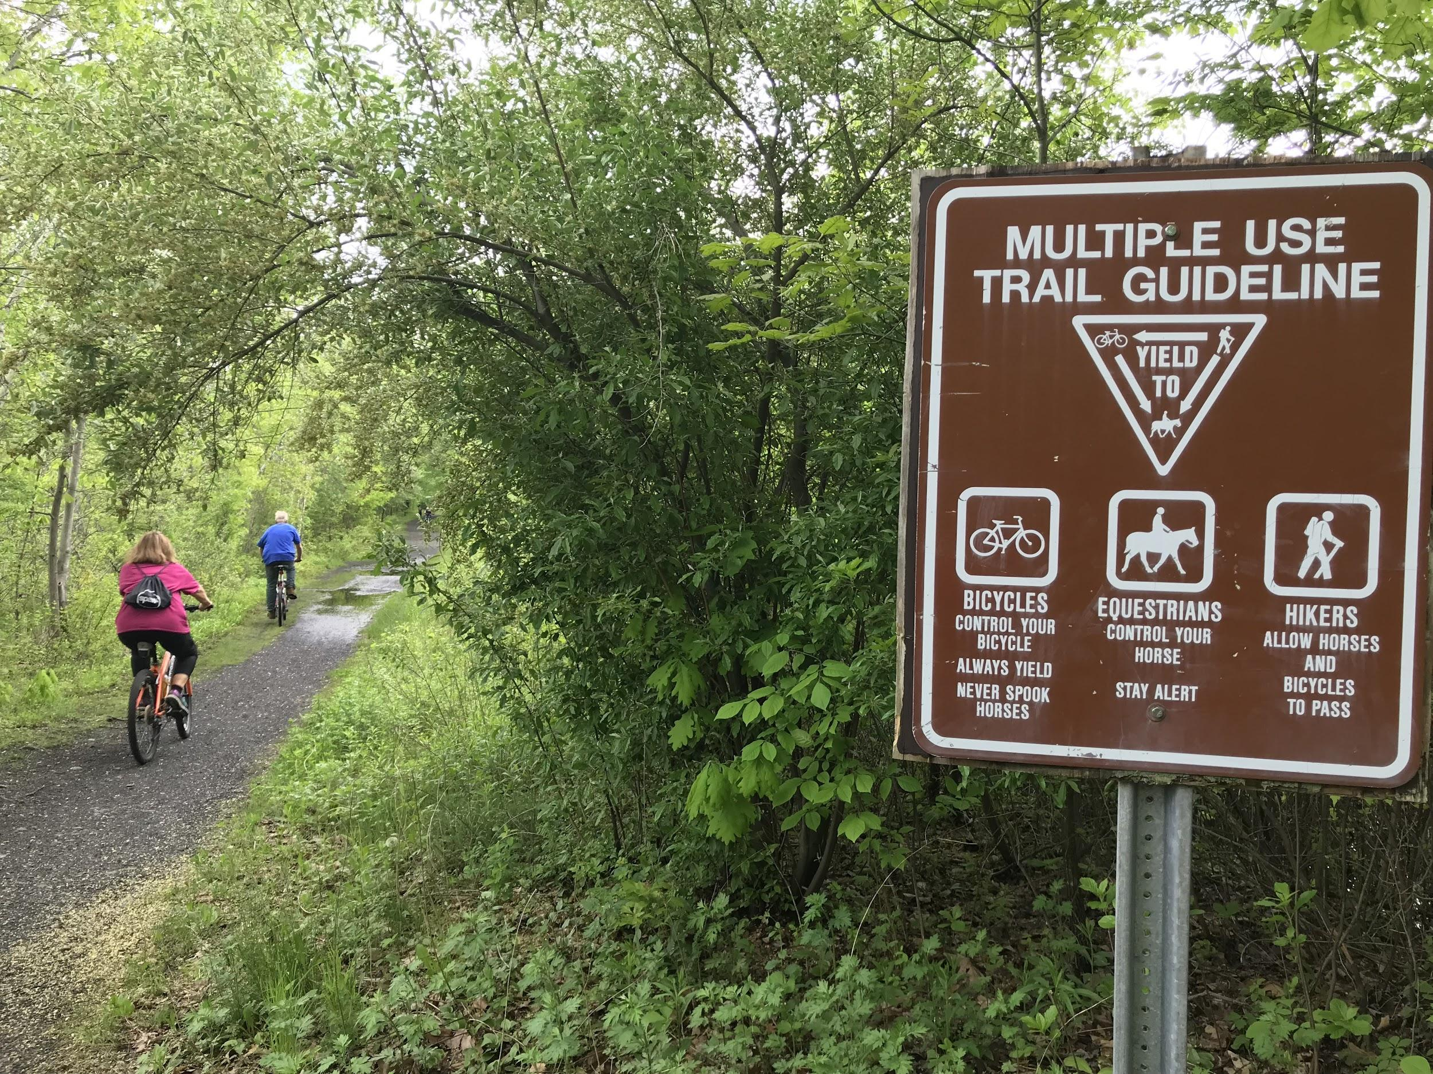
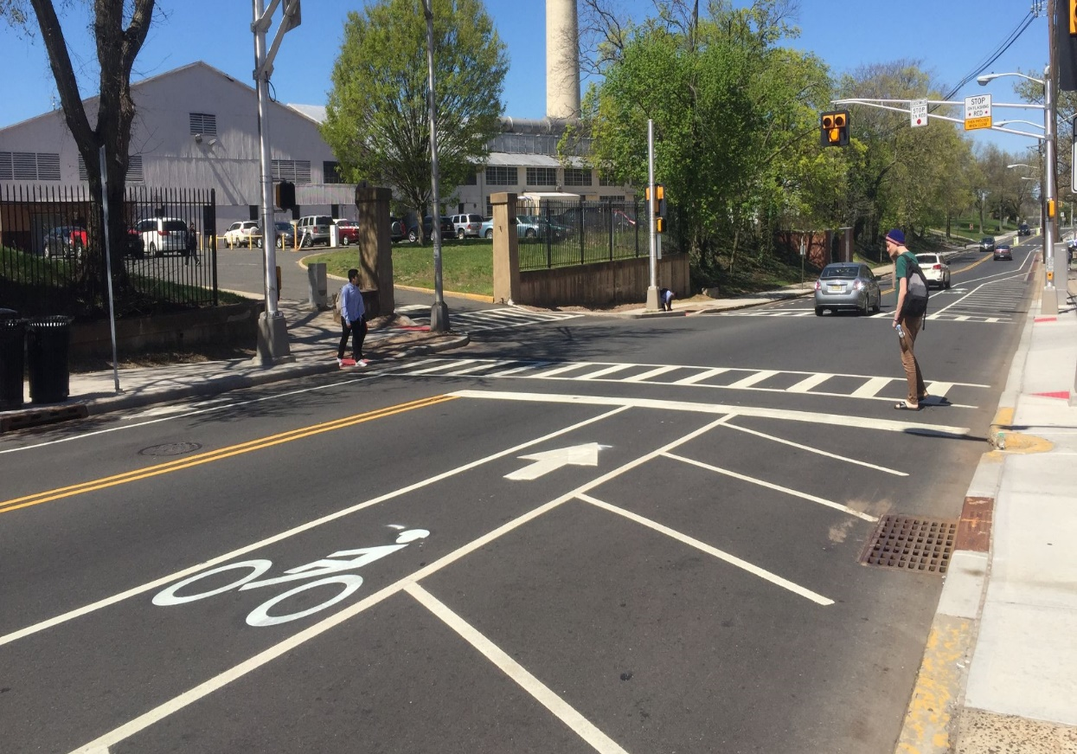
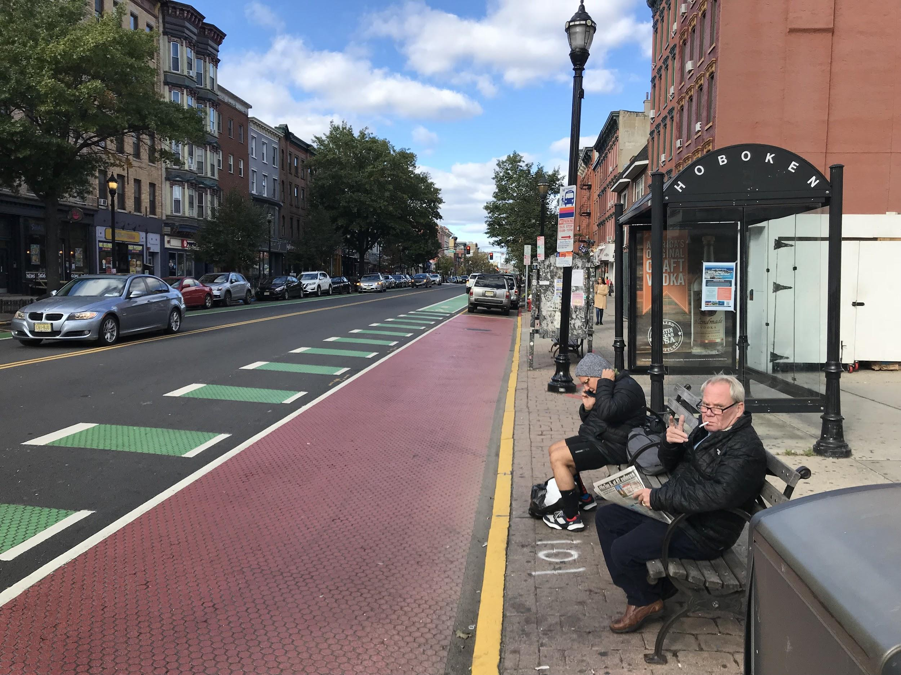
NJDOT TASA Infrastructure Funding
What is TASA funding?
Community-based projects
Transportation projects (land & water)
Expands travel choices
Strengthens the local economy
Improves quality of life
Protects the environment
About SRTS
Vision & Mission
Complete Streets
Safe System Approach
Three Pillars
NJ TMAs
NJDOT Safe Routes Resource Center
NJ Crossing Guards
NJDOT Bike Ped Resource Center
NJDOT
Contact
Notes:
The New Jersey Department of Transportation provides federal funding through the Transportation Alternatives Set-Aside Program or TASA. NJDOT solicits grant applications for infrastructure funding in partnership with the State’s three Metropolitan Planning Organizations. TASA provides federal funds for community-based “non-traditional” surface transportation projects designed to strengthen the cultural, aesthetic, and environmental aspects of the nation’s intermodal system. Surface transportation includes transportation both by land and water.

Slide 28
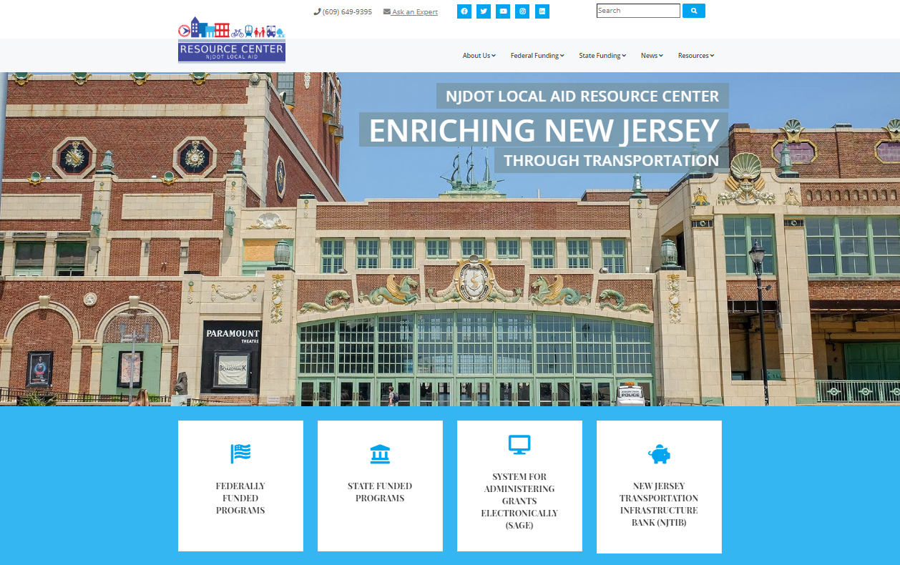
NJDOT Local Aid Resource Center
About SRTS
Vision & Mission
Complete Streets
Safe System Approach
Three Pillars
NJ TMAs
NJDOT Safe Routes Resource Center
NJ Crossing Guards
NJDOT Bike Ped Resource Center
NJDOT
Contact
njdotlocalaidrc.com
Notes:
The NJDOT Local Aid Resource Center provides grant applications and key resources, including handbooks and a dedicated help desk, to support communities in project planning, grant applications, and project delivery. It also offers guidance on navigating federal and state grant processes and more. This is an excellent starting point for all NJDOT grant-related information, with a website featuring comprehensive resources and assistance at njdotlocalaidrc.com.

Slide 29

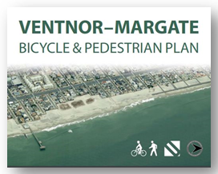
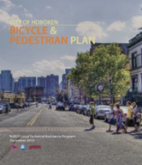

NJDOT Bicycle & Pedestrian Planning Assistance
Local Planning Assistance
Plans in over 100 towns
On-call consultants for a variety of projects:
bicycle and pedestrian circulation studies, pedestrian safety assessments, trail feasibility studies, bikeway plans, crosswalk improvement plans, etc.
About SRTS
Vision & Mission
Complete Streets
Safe System Approach
Three Pillars
NJ TMAs
NJDOT Safe Routes Resource Center
NJ Crossing Guards
NJDOT Bike Ped Resource Center
NJDOT
Contact
njbikeped.org/njdot-local-bicycle-and-pedestrian-planning-assistance-program
Notes:
If your project requires a more comprehensive bicycle or pedestrian plan, the NJDOT Bureau of Safety, Bicycle, and Pedestrian Programs provides planning technical assistance through its Local Technical Assistance program. This initiative has already supported over 100 towns, pairing them with on-call consultants who guide the planning process and help improve walking and bicycling conditions. To learn more, visit: njbikeped.org/njdot-local-bicycle-and-pedestrian-planning-assistance-program.

Slide 30
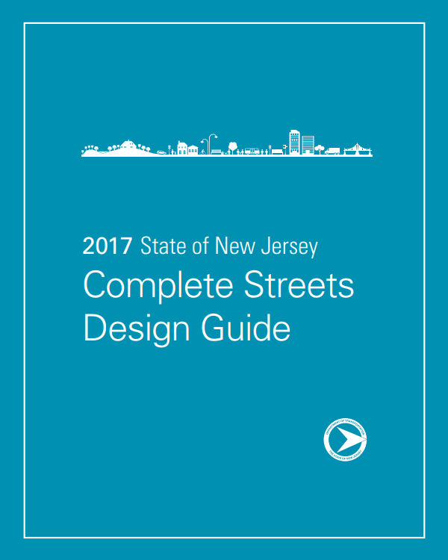
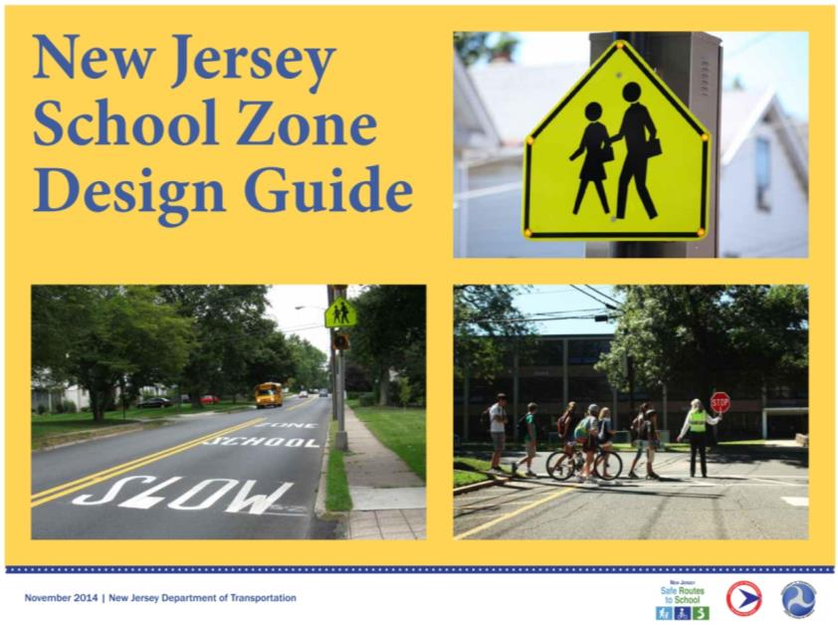
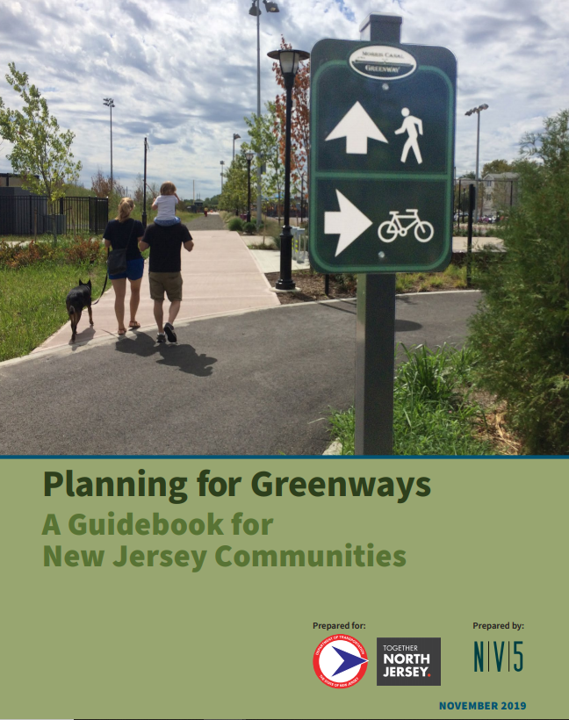
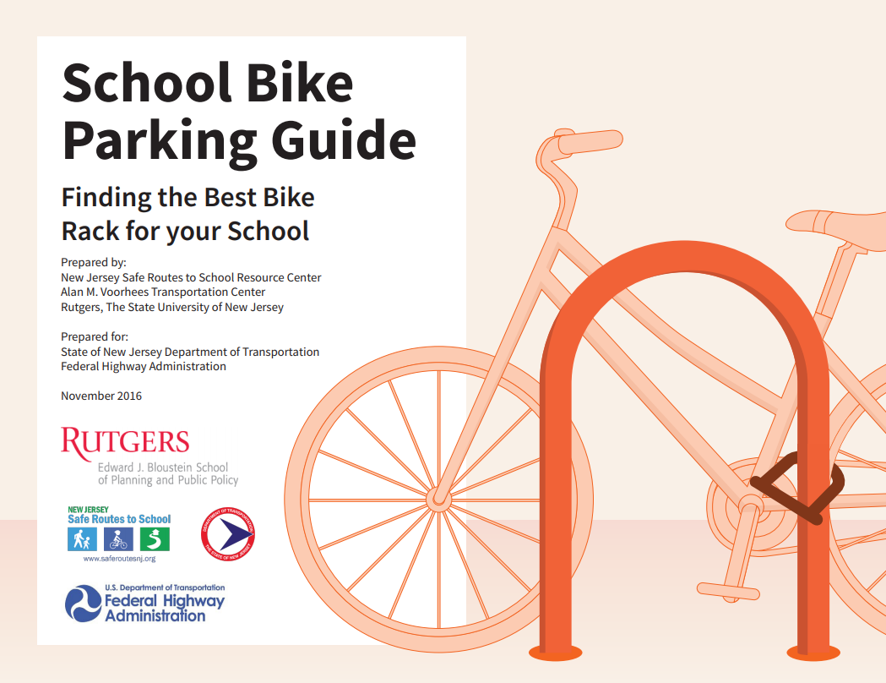
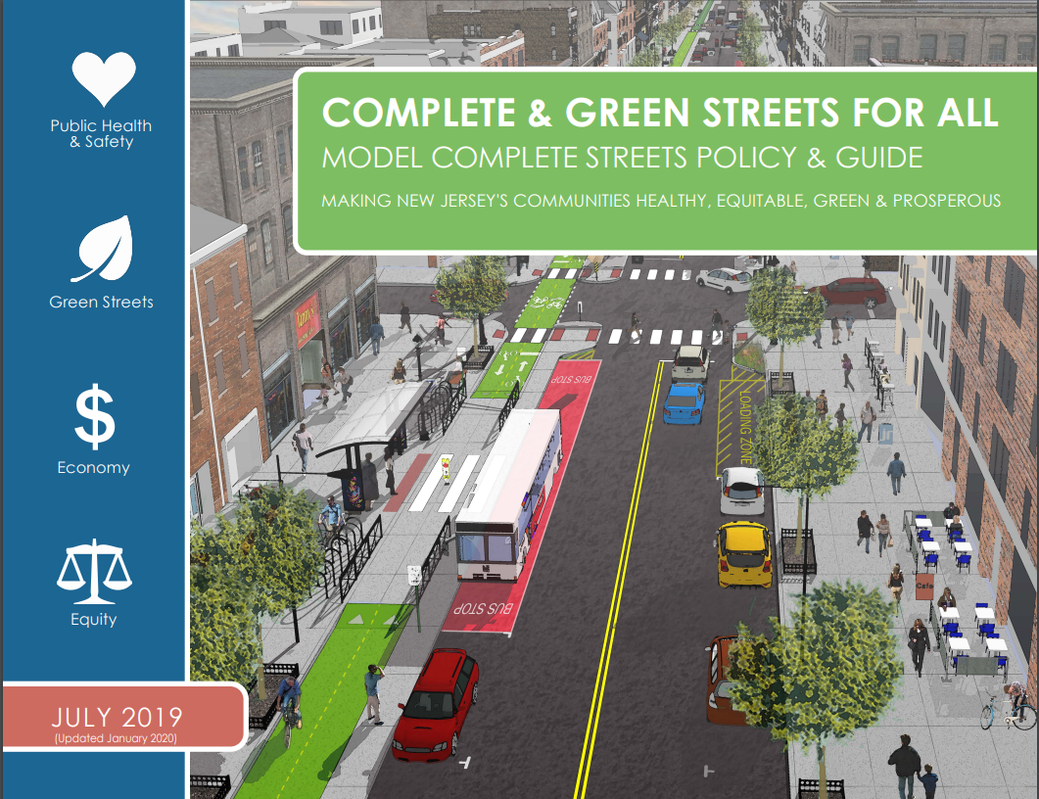
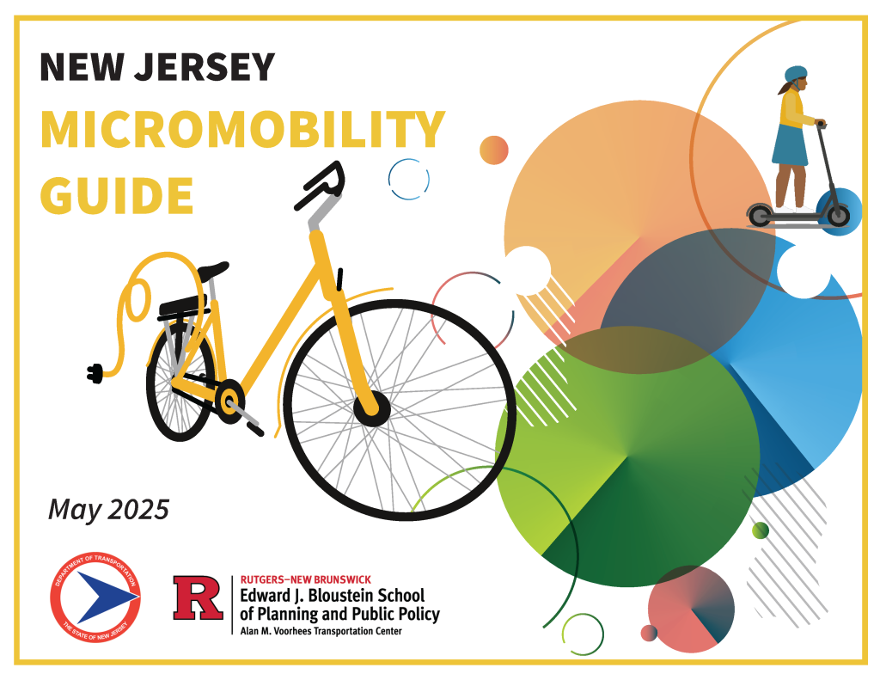
NJDOT Design Guides
Complete Streets Design Guide
School Zone Design Guide
School Bike Parking Guide
Complete Streets for All: Model Policy & Guide
Planning for Greenways Guidebook
NJ Micromobility Guide
About SRTS
Vision & Mission
Complete Streets
Safe System Approach
Three Pillars
NJ TMAs
NJDOT Safe Routes Resource Center
NJ Crossing Guards
NJDOT Bike Ped Resource Center
NJDOT
Contact
Notes:
NJDOT offers an expanding collection of guides, including the Complete Streets Design Guide and Model Policy, School Zone Design and Bicycle Parking Guides, and the NJ Micromobility Guide. These resources compile current best practices to support NJDOT’s vision of a New Jersey where people of all ages and abilities can walk and bicycle safely, conveniently, and with confidence.

Slide 31
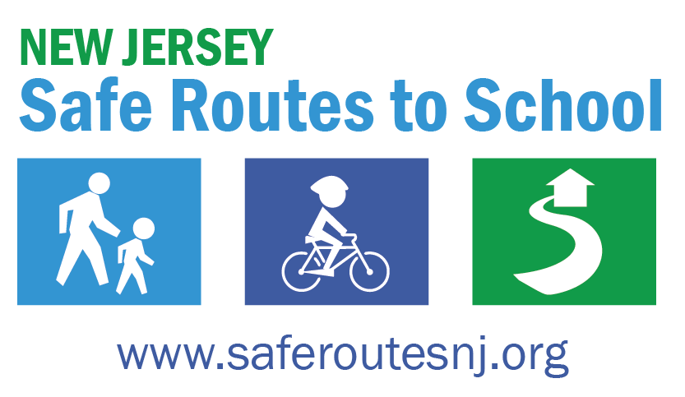

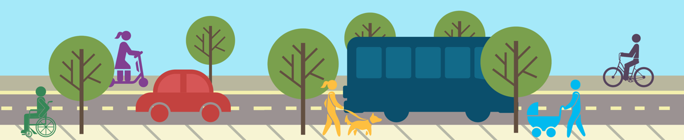
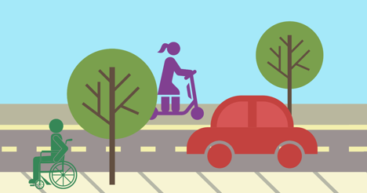
Contact
Thank You!
Contact:
NJDOT Safe Routes Resource Center
Website: saferoutesnj.org
Telephone: (848) 932-7901 Email: srts@ejb.rutgers.edu
About SRTS
Vision & Mission
Complete Streets
Safe System Approach
Three Pillars
NJ TMAs
NJDOT Safe Routes Resource Center
NJ Crossing Guards
NJDOT Bike Ped Resource Center
NJDOT
Contact
Notes:
The New Jersey Safe Routes to School program and its partners are committed to creating safer and healthier communities through active transportation initiatives. For more information and updates, please visit saferoutesnj.org. Thank you!

